Slide 1
UnilSports R-Package
Programming Tools in Data Science

Slide 2
Table of contents
01
Introduction
04
Shiny App
02
R-Package
05
Pkgdown
03
GitHub Repo
Goals and Impact
Operability
Functions descriptions
Website
Files Structure

Slide 3
01
Introduction

Slide 4
Goals and
Impact
Time Consumption
Main Goal
Fat Burn
Introduction
02
03
04
05
Facilitation of activity-search process
Time selection
Sport availability
Optimization on the selection of UNIL/EPFL sport centers activities.
Calorie burn optimizer
Activity focused
Multi-activity centered

Slide 5
02
R-Package

Slide 6
Sports Schedule
01
R-Package
03
04
05
Outcome
Date | Time Table | Activity | Location
2022-12-20 | 07:00-08:00 | Football / Pratique libre | Terrain Central Est
2022-12-20 | 08:00-09:00 | Basketball / Pratique libre à l'extérieur | Basket Entier
2022-12-20 | 09:00-10:00 | Slackline / Tous niveaux | SOS1-Salle 1
… | … | … | …
2022-12-20 | 21:00-22:00 | Football / Pratique libre | Terrain Central Sud
Function
webscrape_sports()
Tables of sport activities
Web Scraping website
Sport.unil.ch

Slide 7
METs Values
01
R-Package
03
04
05
Outcome
Activity | Specific Motion | METs
bicycling | bicycling, mountain, uphill, vigorous | 14.00
bicycling | BMX | 8.50
bicycling | mountain, general | 8.50
… | … | …
dancing | aerobic, general | 7.30
Function
webscrape_MET()
Table of METs values of +800 activities
Web Scraping website
ProCon.org

Slide 8

Wrangling & Cleaning
01
R-Package
03
04
05
Outcome
Date | Start Time | End Time | Duration time | Activity | Location | MET Values | P
2022-12-20 | 7.00 | 8.00 | 60 | Football / Pratique libre | Terrain Central Est | 8.0 | 8.4
2022-12-20 | 8.00 | 9.00 | 60 | Basketball / Pratique libre à l'extérieur | Basket Entier | 6.5 | 6.8250
2022-12-20 | 9.00 | 10.00 | 60 | Slackline / Tous niveaux | SOS1-Salle 1 | 7.3 | 11.4975
… | … | … | … | … | … | … | …
2022-12-20 | 19.00 | 20.00 | 60 | Football / Pratique libre | Terrain Central Sud | 8.0 | 8.4
Function
get_cleanschedule_met()
Table generation for mapping activities
Time transformations
Tables Mapping
Notes:
Mandy: Then we prepare the data we scraped by creating ‘get_cleanschdule_met()’ function.

Slide 9

Optimization Function
01
R-Package
03
04
05
Outcome
Function
optimize_schedule()
Start Time | End Time | Duration time | Activity | Location | Calburn
7.00 | 8.00 | 60 | Football / Pratique libre | Terrain Central Est | 420.00
8.00 | 9.00 | 60 | Basketball / Pratique libre à l'extérieur | Basket Entier | 341.25
9.00 | 11.00 | 120 | Slackline / Tous niveaux | SOS1-Salle 1 | 600.00
Function that calculates calorie burn based on 3 constraints
Total calorie vs Target calorie
No overlapping time slots
Activity selection
Notes:
Mandy: Our 4th function is optimization function. We use ‘Integer programming (always return positive integer outputs or zero) ’ to find solutions. Our objective function is

Slide 10

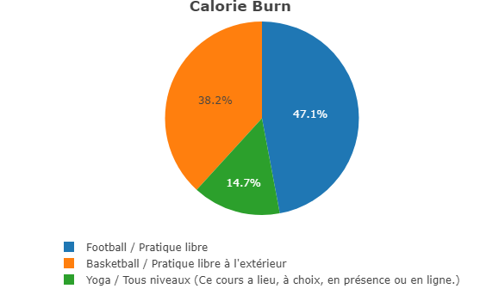
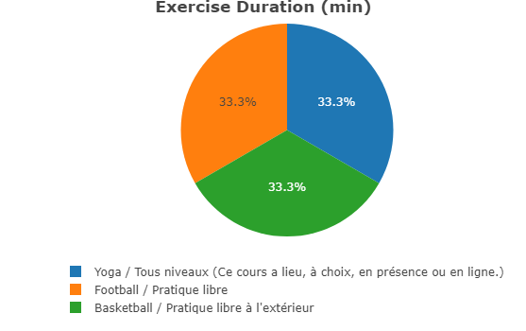
Pie Chart Function
01
R-Package
03
04
05
Function
pie_optim()
Reflects the outputs of the optimization function
Calorie burn % per activity
Exercise duration % per activity
Notes:
Mandy:

Slide 11

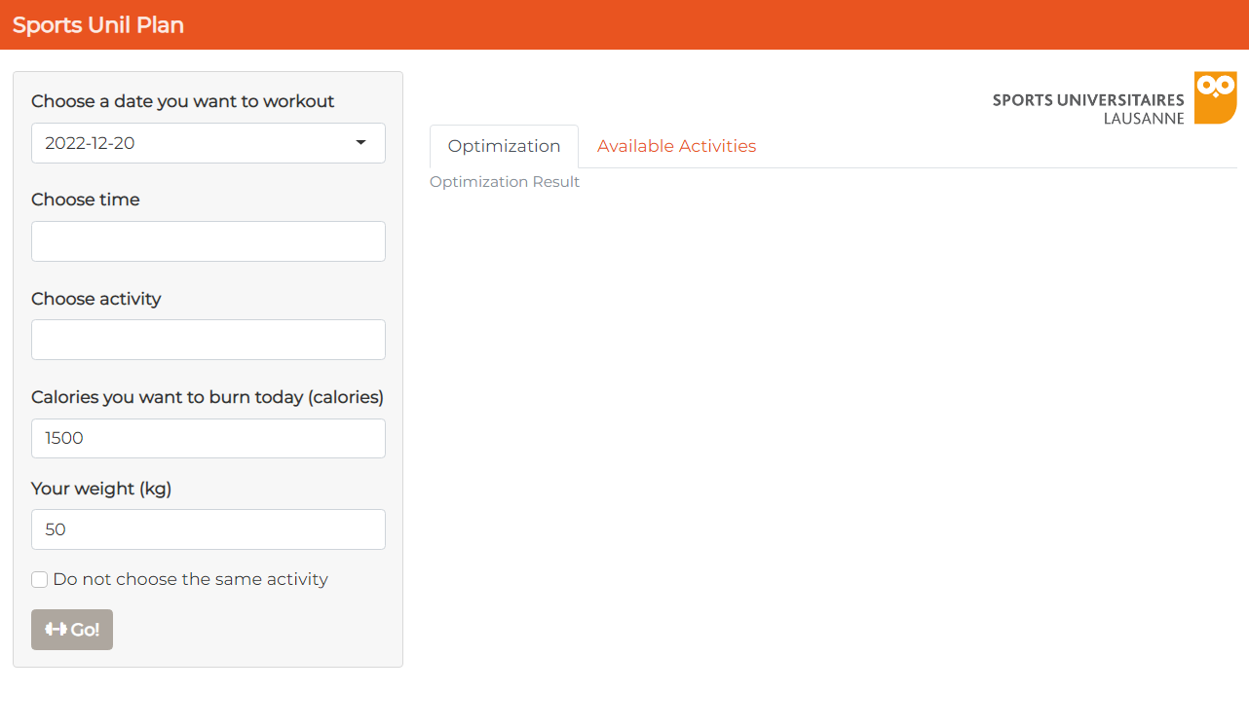
Start Shiny App
01
R-Package
03
04
05
Function
startApp()
Runs the Shiny app of UnilSports
It contains the functions
build_ui() = creates the user interface
build_server() = generates the server for the app

Slide 12
03
GitHub Repo

Slide 13
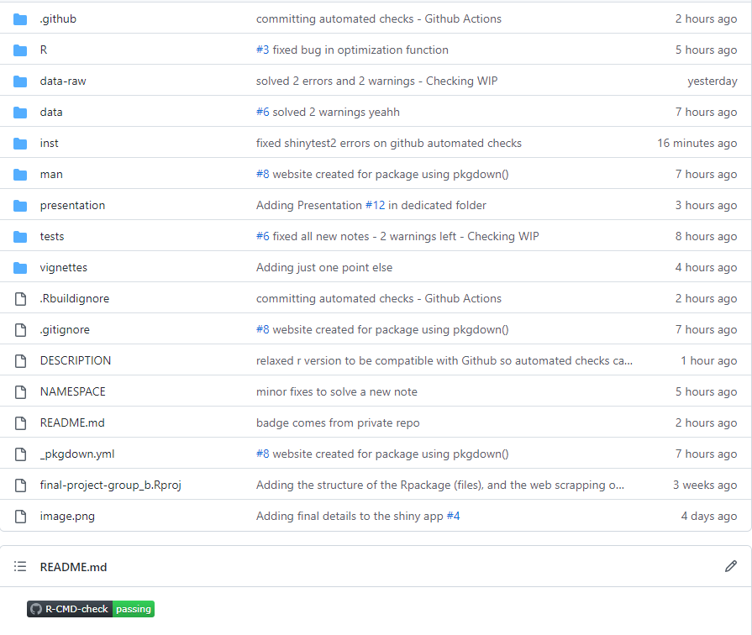
GitHub Repository
01
02
GitHub Repo
04
05

Slide 14
04
Shiny App

Slide 15
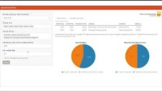
UnilSport Shiny App
01
02
03
Shiny App
05

Slide 16
05
Pkgdown

Slide 17
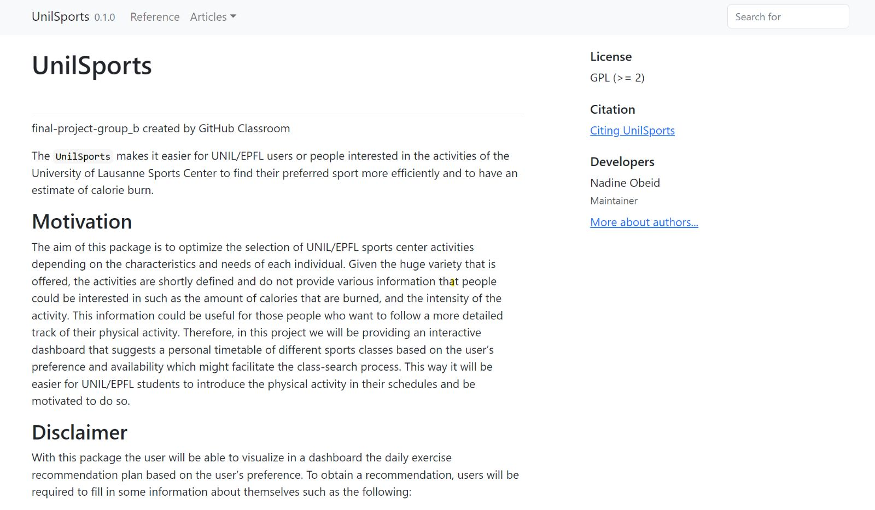
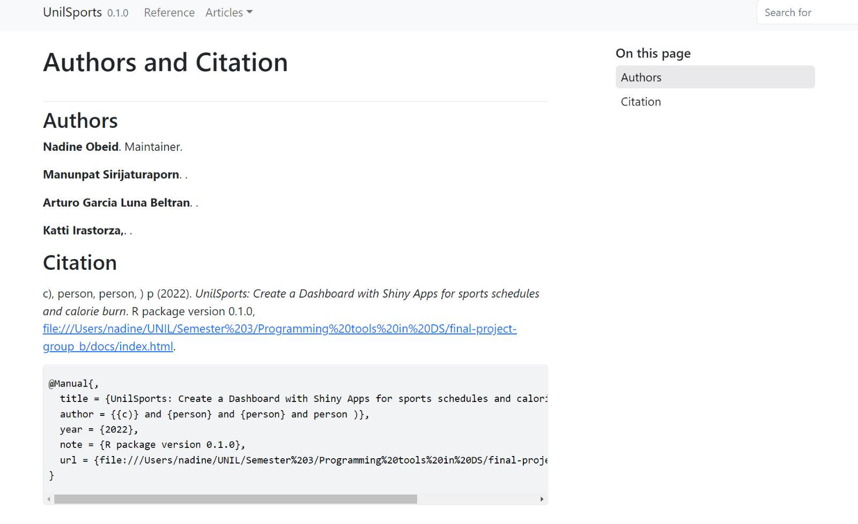
Pkgdown website
01
02
03
04
Pkgdown

Slide 18
Thanks!
Do you have any questions?

